Slide 1
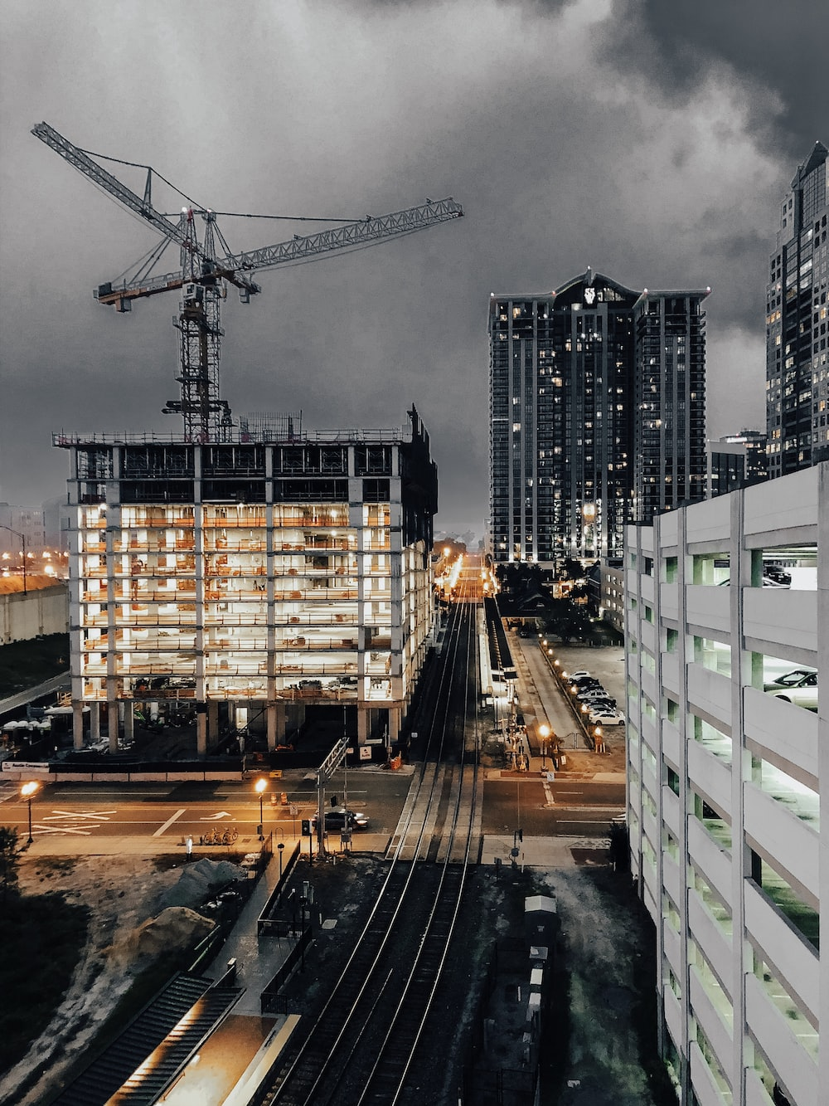
PROJECT MANAGEMENT SYSTEM
VISUAL PROGRAMMING
COSC 31112
BUILDING & CONSTRUCTION
Group no : 01

Slide 2


About system
A project management system is a digital tool designed to help individuals and teams efficiently plan, execute, and track the progress of projects.
It provides a centralized platform where users can define project goals, allocate tasks, set deadlines, assign responsibilities, and monitor the overall project timeline.
This system facilitates collaboration by allowing team members to communicate, share files, and update their progress in real time.
Additionally, it offers features such as milestone tracking, resource management, and reporting to ensure projects are completed on time and within scope.

Slide 3

Functional Requirement
Project Planning and Scheduling
Resource Management
Reporting and Analytics
Data Management
Progress Tracking

Slide 4
Non - Functional Requirement
Security and Privacy
Performance
Reliability
Usage
Maintainability
Compatibility
User-friendly interface

Slide 5



Tools &Technology
Tools
Technology
Visual Studio
.NET framework
Microsoft SQL server
Draw.io
Canva
Microsoft Office
C# language
Windows Forms Controls
Windows Forms Chart Control
ADO.NET
Database Querying
Event Handler Methods
Forms Navigation

Slide 6
Application demo video
NEXT

Slide 7


Slide 8


Future Enhancement & challenges
Online Collaboration
Communication Gaps
Motivation and Accountability
Time, Task & Workload Management
Conflict Resolution:
Progress Tracking
Scheduling Conflicts
Coordination
Future Enhancement
AI and Machine Learning
Advanced Reporting and Analytics
Blockchain Integration
IoT Integration
Automation of Routine Tasks
Enhanced Mobile Experience
AI-driven Risk Management
Resource Optimization
challenges

Slide 9
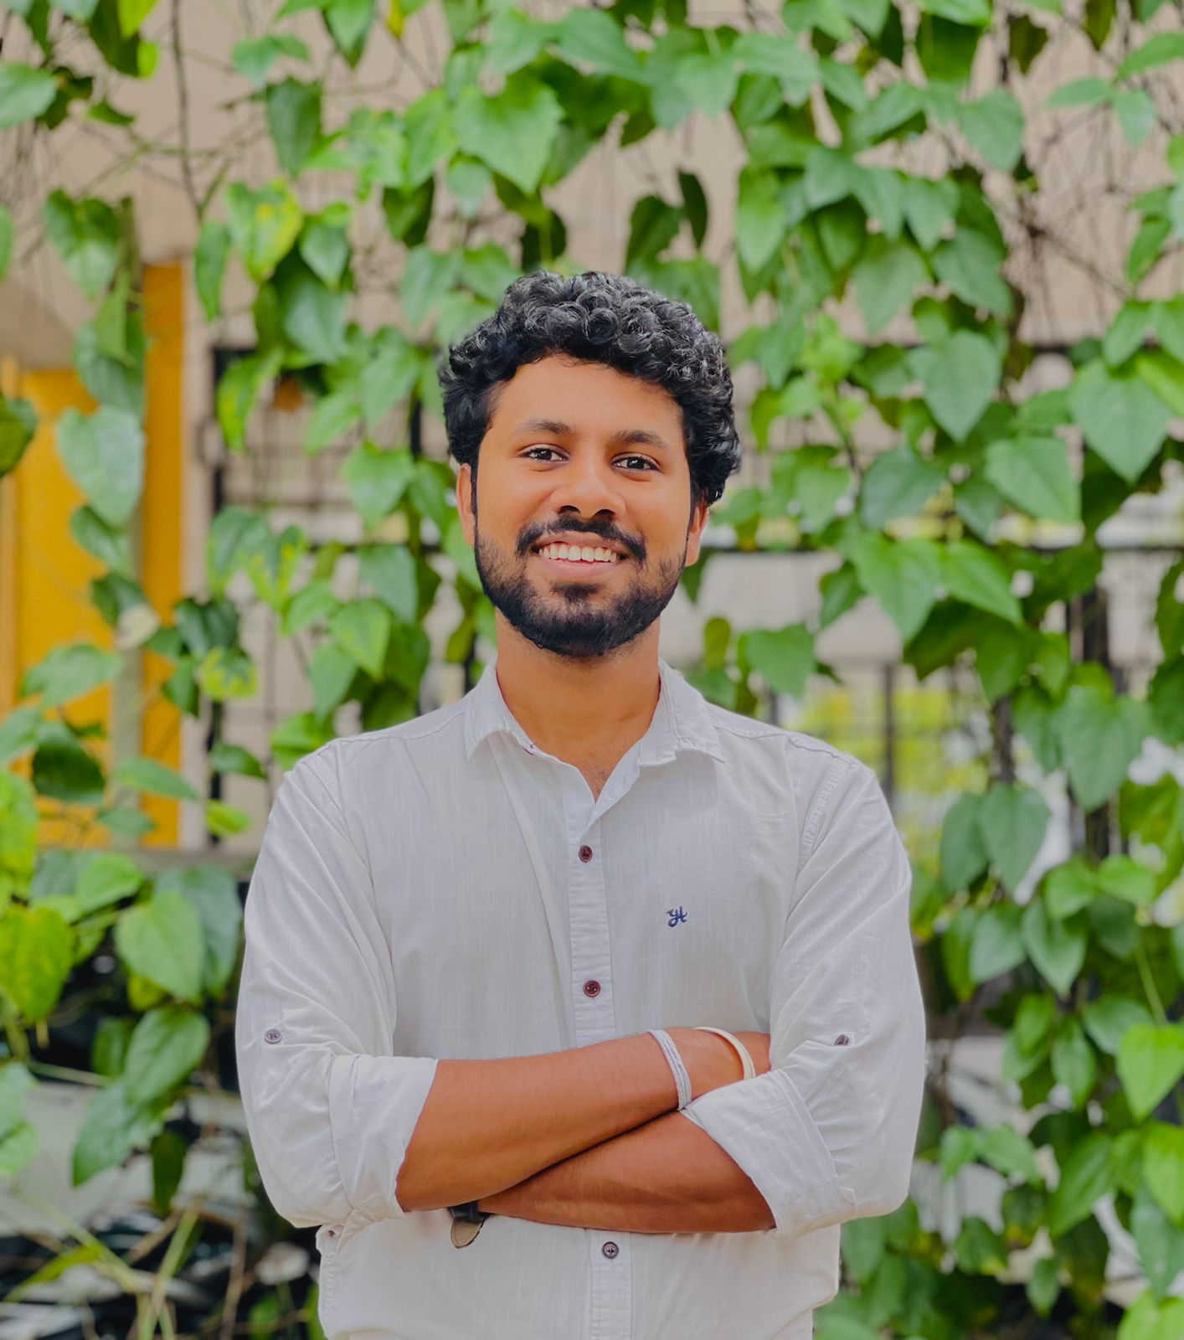
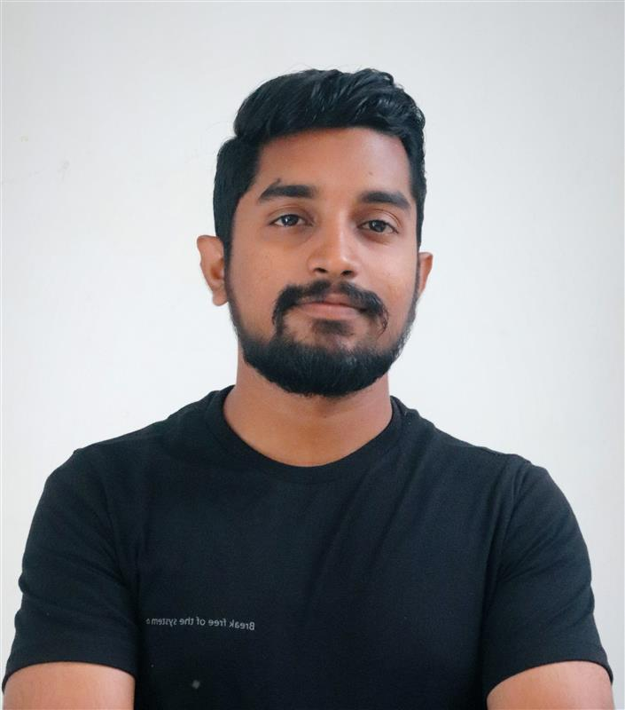
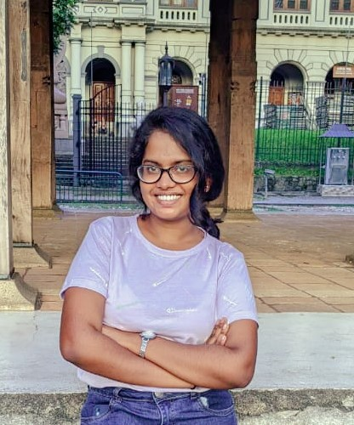
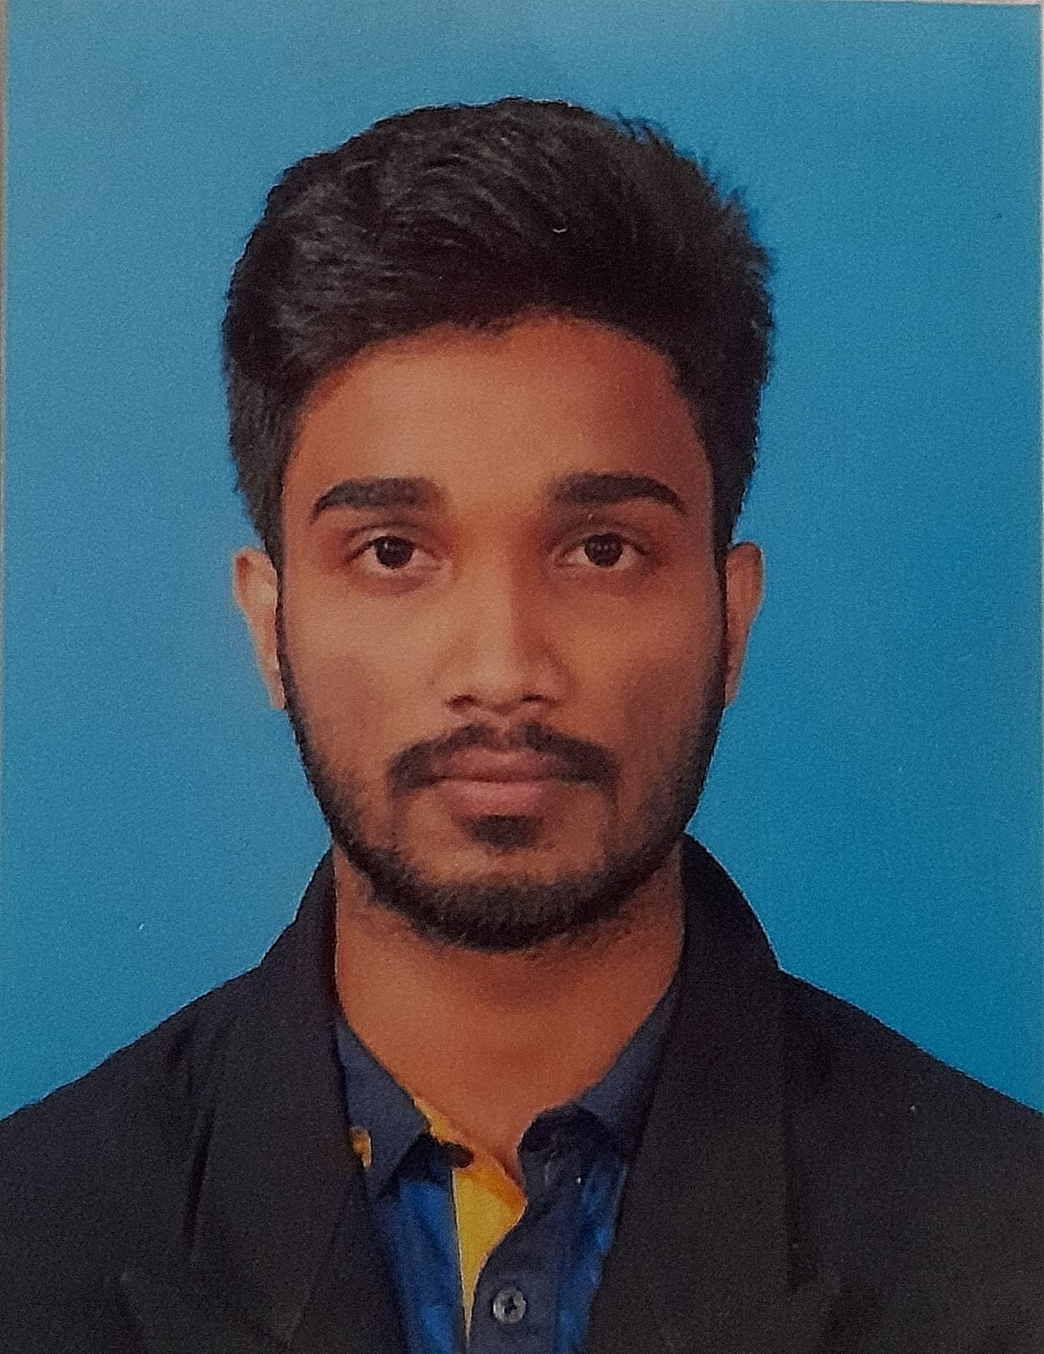
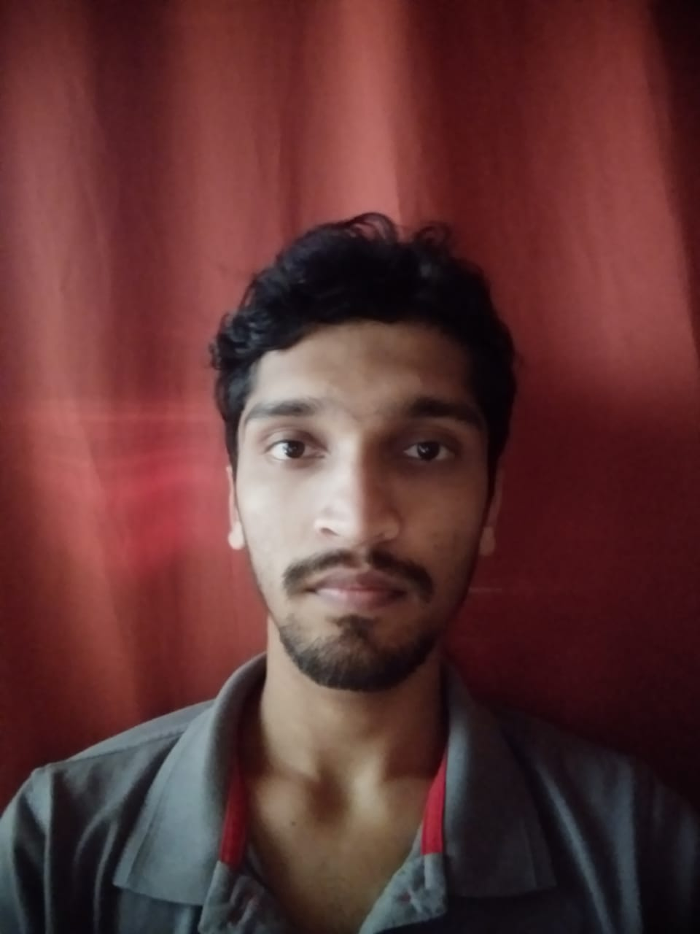
Our team
Harshana Eshan
PS / 2019 / 137
eshanhg-ps19137@stu.kln.ac.lk
+94 71 604 8560
Chameera Peshan
PS / 2019 / 265
wijerat-ps19265@stu.kln.ac.lk
+94 76 007 8842
Randila Shehari
PS / 2019 / 225
gunarat-ps19225@stu.kln.ac.lk
+94 71 696 4666
J.M.N.C.Jayamanne
PS / 2019 / 244
jayaman-ps19244@stu.kln.ac.lk
+94 71 568 6673
D.H.G.Lahiru
PS / 2019 / 022
lahirud-ps19022@stu.kln.ac.lk
+94 76 927 9527

Slide 10

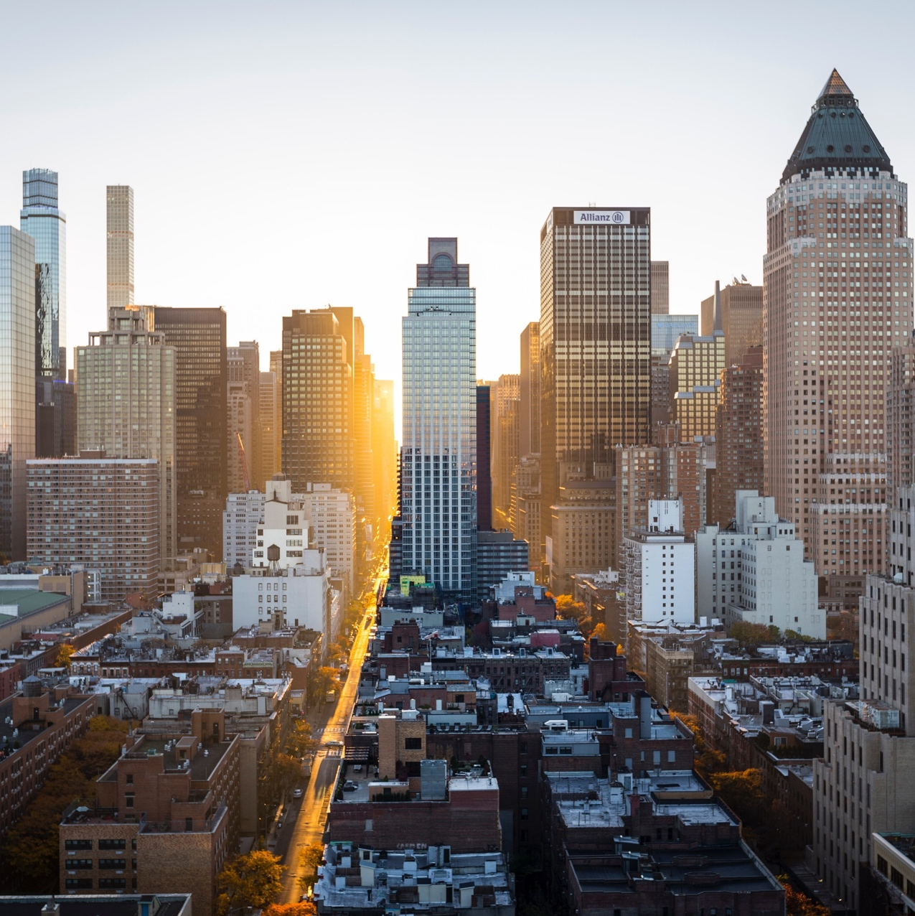
Thank you!
abc@company.com
+94 ## #### ###

